Slide 1

Usage of Genetic Algorithm for Path Planning of CC-2800 Heavy Crane
Noghabaee, M., Taghaddos, H., and Keyhani, N.
University of Tehran

Slide 2
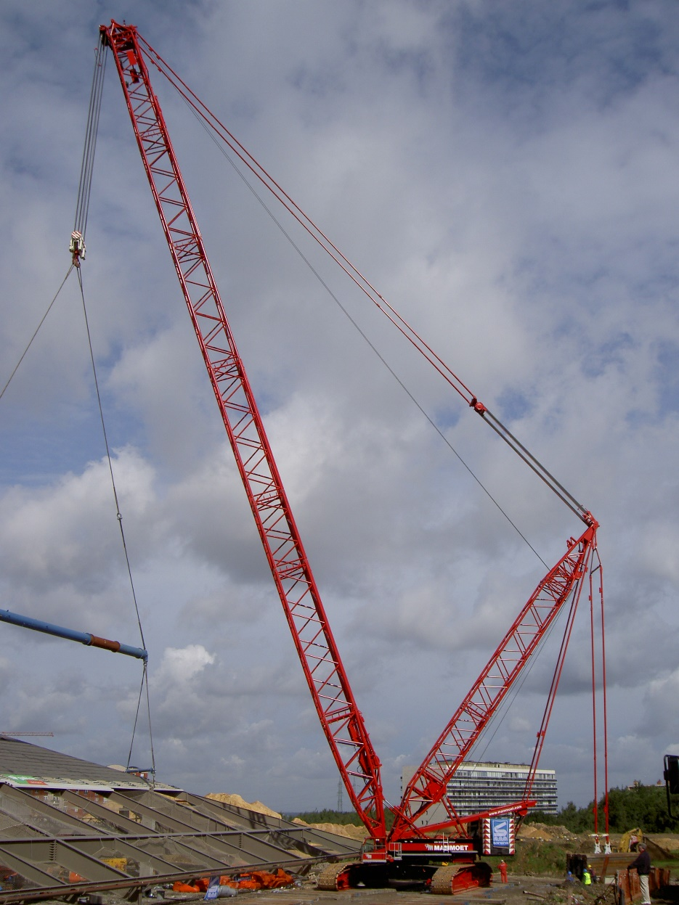
CC-2800 Demag Heavy Crane
Advantages :
Heavy Lifts
Modular Constructions
Disadvantages :
High Costs
Low Maneuverability
Hard Optimization
Hard Clearance Calculations

Slide 3
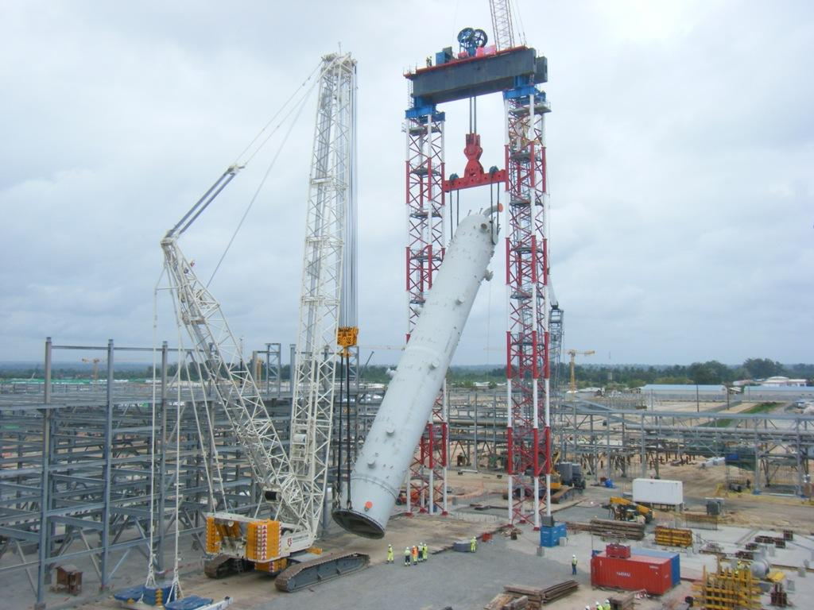
Using of Genetics Algorithm
There are a lot of methods for optimization But none of them can completely optimize the path of crane for the following reasons
Hard Clearance Calculations
Lots of Different Movements

Slide 4
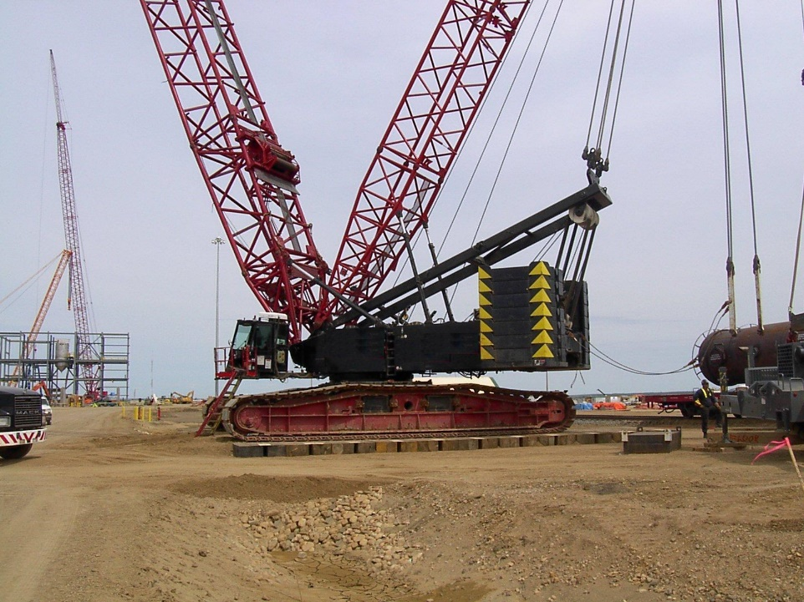
Our Progress
Loading Obstacles from Database
Optimizing the Movement without Calculating the Clearances
Reasonable Timing on Calculations (10000 Generation in 6 Hours)
Possibility for Changing Target Function
Create Animation in 3D for Movements
Possibility for Creating Virtual Reality Animations

Slide 5
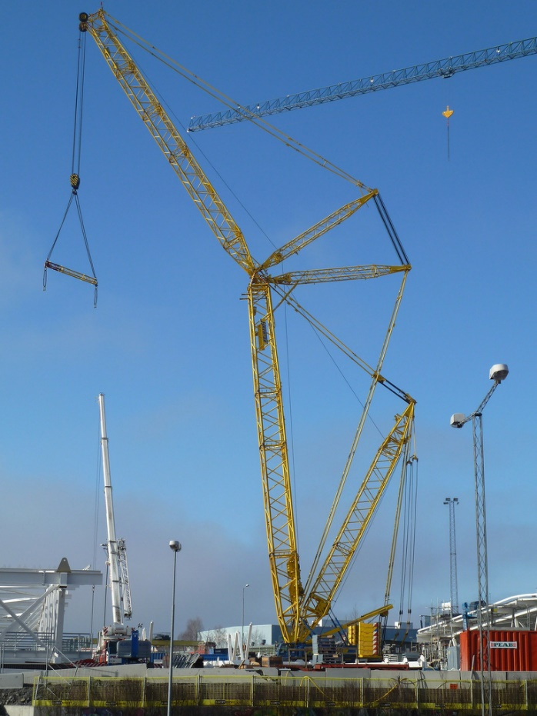
Now we are developing a code to calculate the clearances and after this we are going to add Jib to our crane and changing the boom length

Slide 6
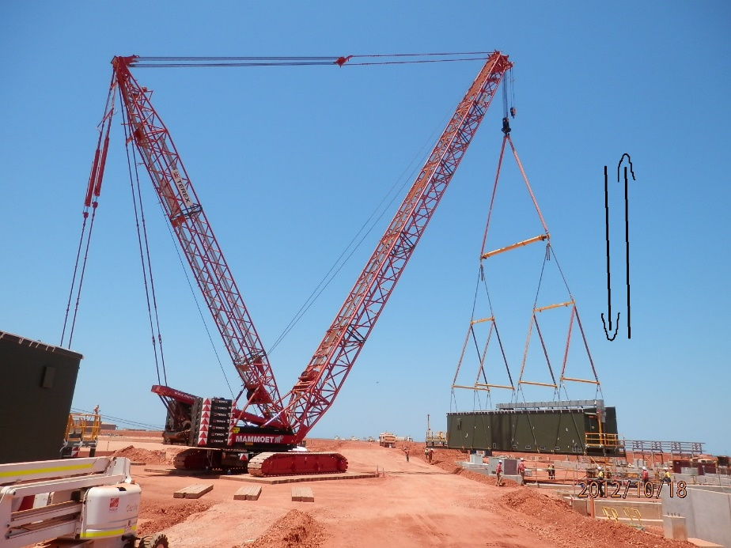
How We Used GA
Every Chromosome is a path and each gene shows how crane act in that gene for example if a gene is 2 crane lift goes up one unit.
One of the key problem of our work was developing a genetics algorithm because we couldn’t use others codes and we should develop our codes.
Now Our codes is about 3000 lines.

Slide 7
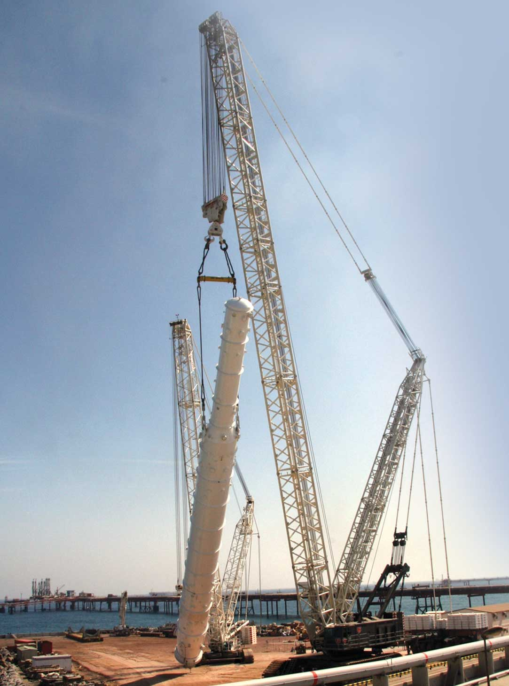
Thank You For Your Attention

